Slide 1


NetspectiveAttest
Automated assessment questionnaires, response scoring, and compliance reporting system.
1
CREATE ASSESSMENTS
Use our library of existing assessment forms or create your own. If you’re too busy, just hire our partners to execute on your behalf.
2
DISTRIBUTE TO RESPONDENTS
Use e-mail invitations to distribute assessments to dozens or hundreds of responders (internal teams or external suppliers) in minutes.
Opsfolio Attest is the easiest way to create requests for information (RFIs) or assessment questionnaires, quickly share them with respondents, score them, and track compliance or longitudinal answers.
Spending more time reviewing your assessment responses and improve your internal risk management, 3rd party risk management, and other process improvement tasks.
3
COLLECT DATA & AUTO SCORE
As suppliers and vendors enter and submit data, auto score their responses to find hotspots.
4
CONTINUOUS COMPLIANCE
Track who’s in compliance and prepare routine reports quickly.

Slide 2
Netspective Attest Demo
2
URL: https://training.attest.cloud
Login User Name | Password | Account | Role
karl@attest.cloud | karl@123$ | All | SUPER ADMINISTRATOR
alex@attest.cloud | alex@123$ | North West Hospital | ANALYST, ASSESSOR
john@attest.cloud | john@123$ | Forrest General Hospital | ASSESSEE
To see the notification emails use the same email address and password as above. For Webmail access go to https://mail.opsfol.io/

Slide 3
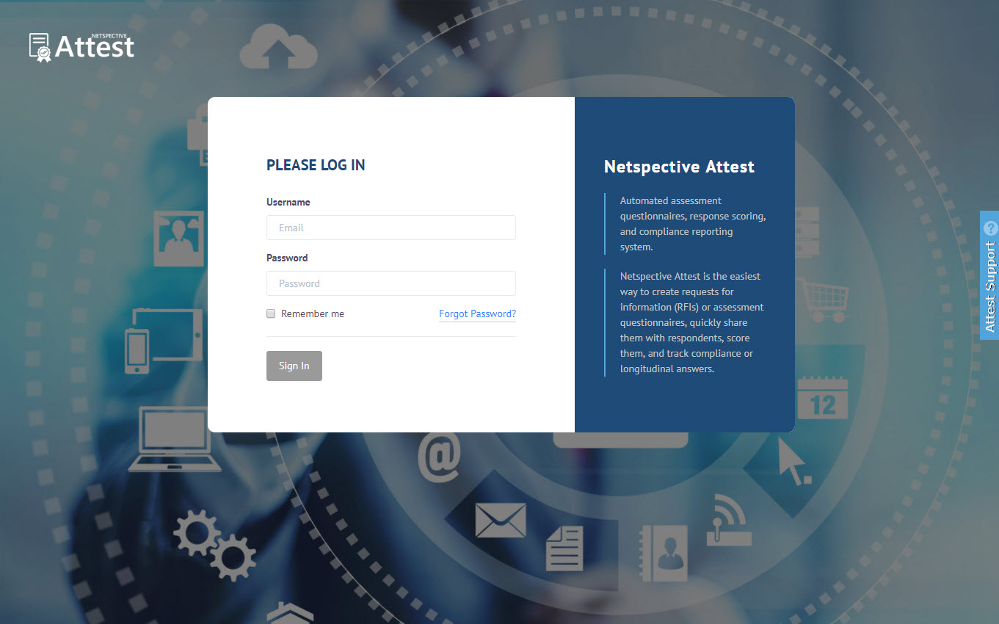
Netspective Attest Login
3
1
LOGIN
All users can login to the system with their user credentials.
2
Analyst
Analyst users can login to Netspective Attest to create assessments.
3
Assessor
Assessor users can login to Netspective Attest to view the assessments.
4
Assessee
Assessee users can login to Netspective Attest for doing assessments.

Slide 4
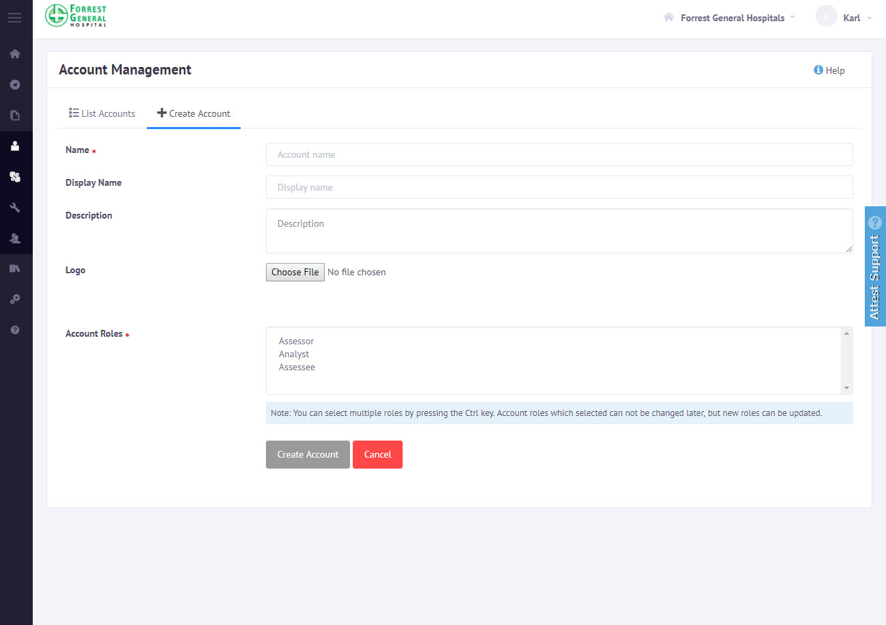
Create Accounts in Attest
4
Super Administrator creates accounts for organizations
1
Login as Super Administrator
Login as Super Administrator to create accounts.
2
Accounts
Super Administrator can create accounts for the Analyst, Assessor and Assessee.
3
Sign up
Analyst users can invite an Assessee to join an Account .

Slide 5
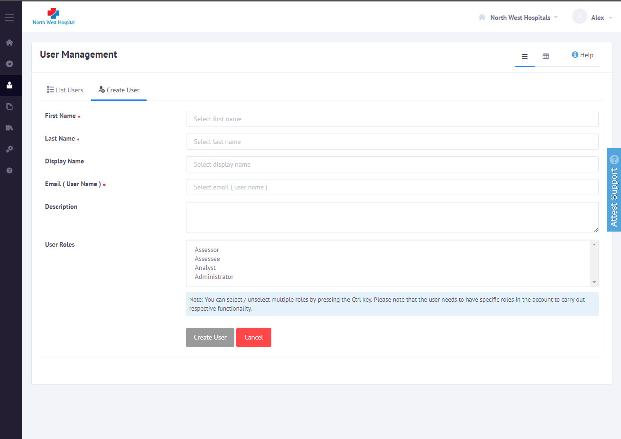
Create Account Users
5
Create users in different accounts and assign one or more roles.
1
LOGIN
All users can login to the system with their user credentials .
2
Account Administrators
After creating accounts Super Administrator can create Account Administrators
3
Analyst
Analysts can create assessments or create custom questionnaires.
4
Assessor
Assessor can view assessments

Slide 6
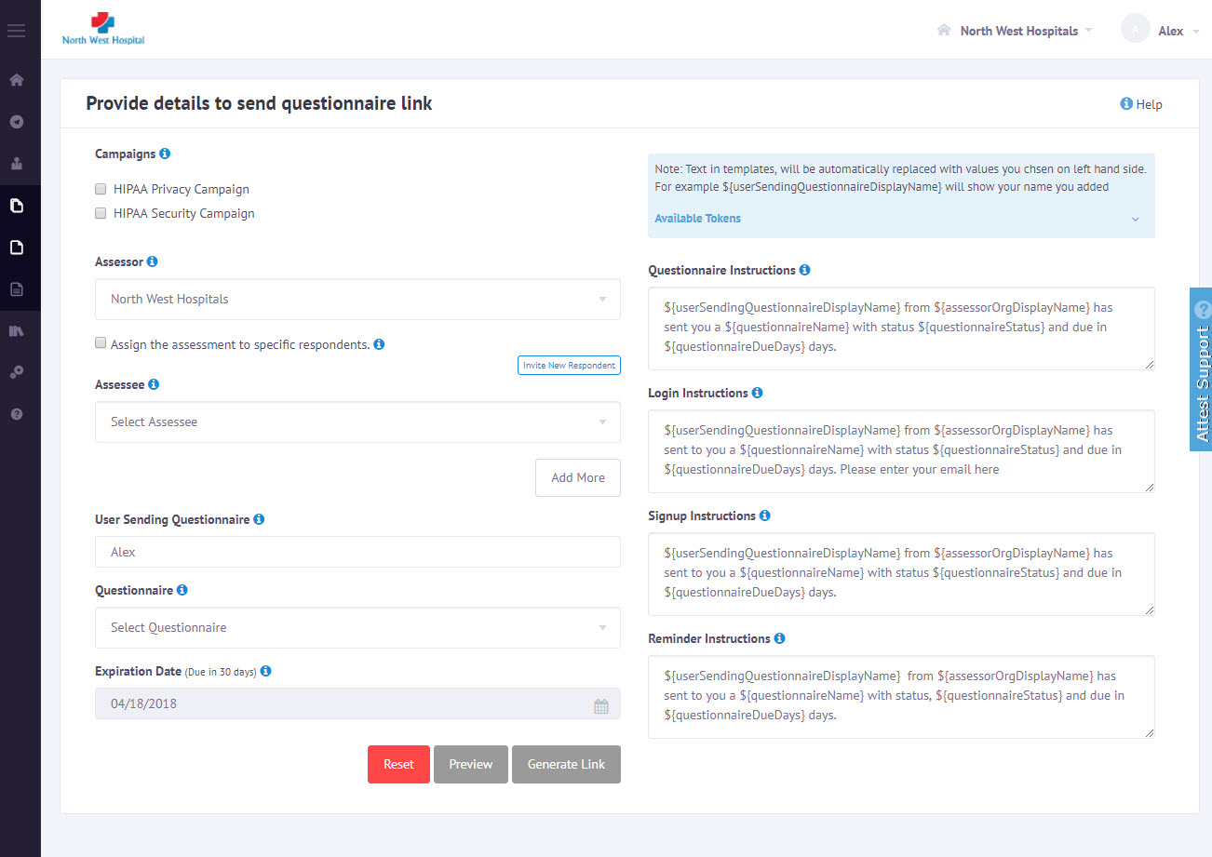
Create Assessments
6
Analyst user creates an assessment link by selecting Assessor and Assessee organizations.
1
Create campaigns for assessments
Select one or more campaigns from the list of campaigns.
2
Assessor and Assessee organizations
Select Assessor and Assessee organizations from the drop down list.
3
Assessment Questionnaire
Select questionnaire from the available list of questionnaires.
4
Preview assessment
Use the preview functionality to see a preview of the assessment questionnaire.

Slide 7
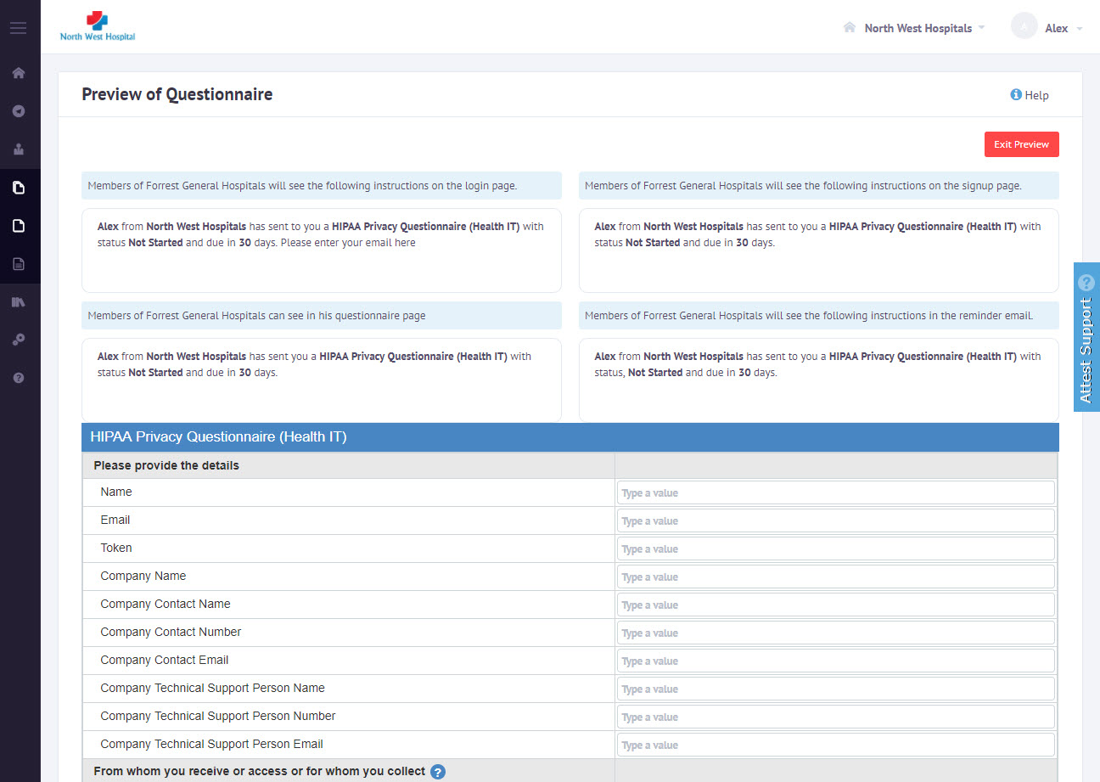
Analyst Preview Questionnaire
7
Analyst user can preview the questionnaire before sending to the assessee
1
Preview Assessment Questionnaire
Ensure the Assessee, Assessor and Questionnaire Name along with expiration dates
2
Update instructions
After checking preview update assessments instructions if needed
3
Back to Create Assessment
After checking preview Continue with create Assessment

Slide 8
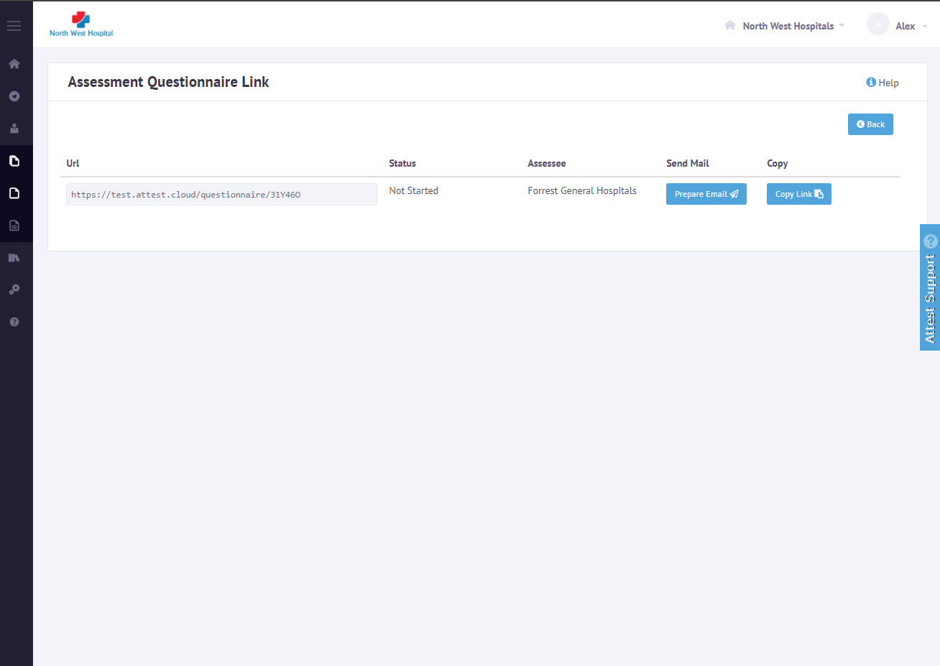
Analyst Send Questionnaire Link
8
Analyst user can send the questionnaire link to the respondents
1
Preview
Questionnaire link will be generated and displayed in the text area.
2
Respondents
This link can be shared with the Respondents.
3
Prepare Email
To send this link to the Assessee, Click Prepare Email for editing or click on Copy Link button to copy it to the clipboard.

Slide 9
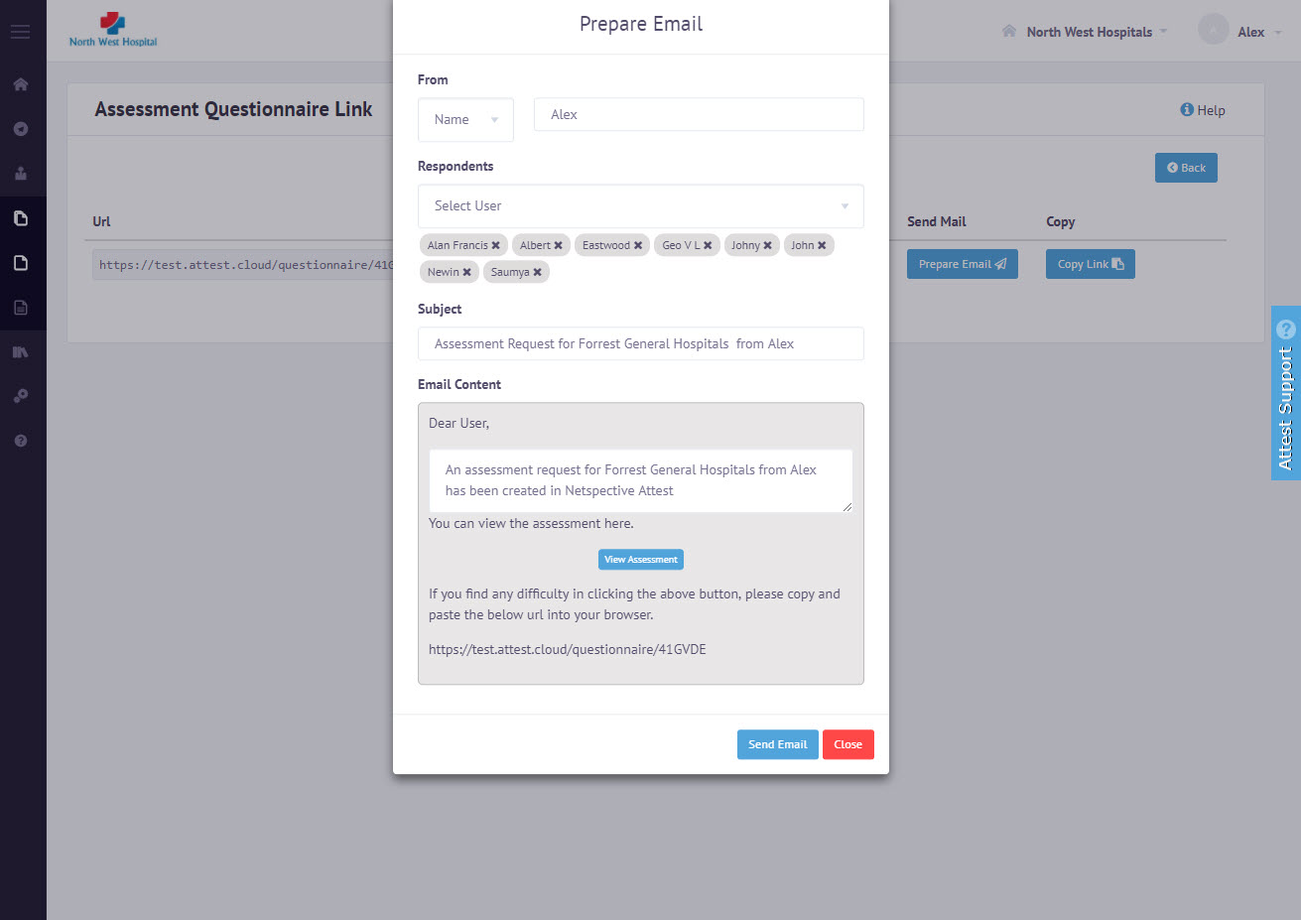
Analyst Prepare Assessment Request
9
Analyst user can customize the email content before sending it to respondents
1
Instructions
To send a customized message, the analyst can edit the default email template content.
2
Name
Sender name can be either the analyst name or system generated
3
Send Email
Clicking on Send Email button will send the email to the Respondent

Slide 10
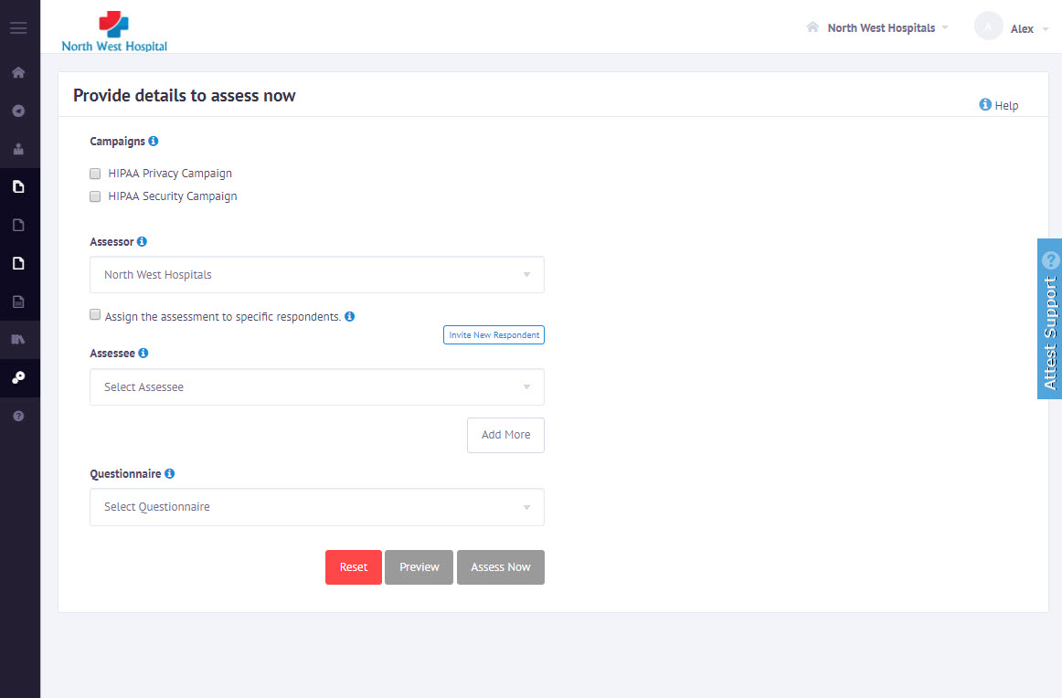
Analyst Assess Now for Assessee
10
Analyst user can customize the email content before sending it to respondents
1
Assessor and Assessee organizations
Select Assessor and Assessee organizations from the drop down list.
2
Assess Now
Analyst have option to do assessments on behalf of Assessee
3
Send Email
Clicking on Send Email button will send the email to the Respondent for view and update further

Slide 11
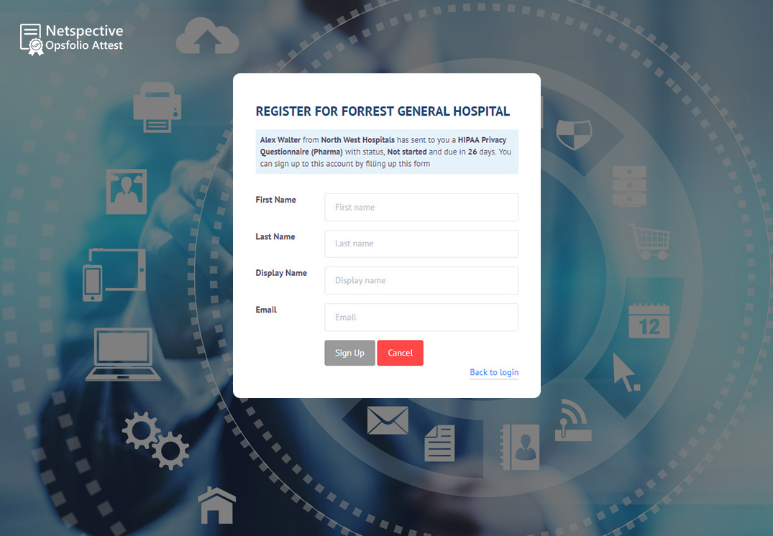
Respondent User Signup
11
Respondent users can register and view the assigned assessment
1
Respondent can register if he has no account
Respondent can sign up (if not done already) using the assessment link shared by the analyst
2
Enter user details
Respondent can add name and details as part of sign up process

Slide 12
Respondent User Login
12
Respondent can login using Assessment link
1
Respondent can login if he/she has account
By using the assessment link shared by analyst an respondent can login to the system
2
Assessments
After login the respondent user can select one of the assigned questionnaires

Slide 13
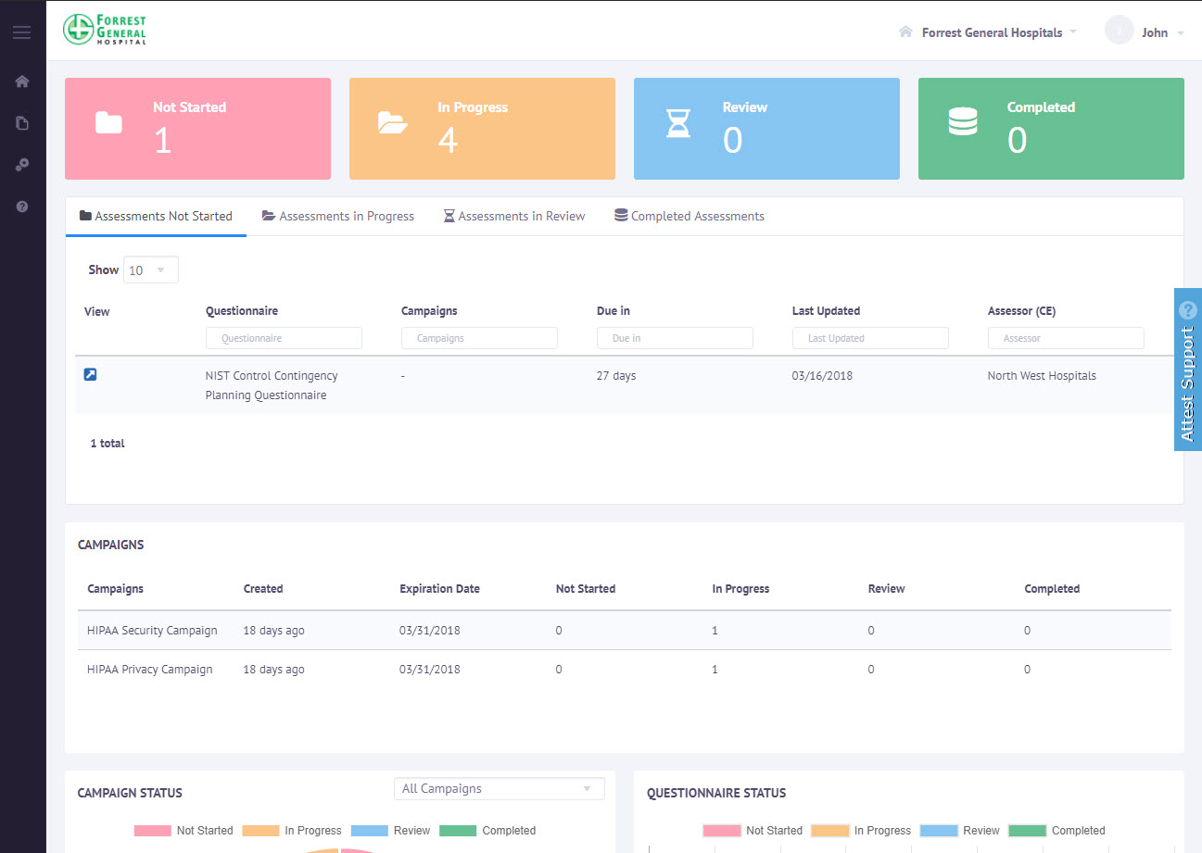
Respondent User Dashboard
13
List all assigned assessments in dashboard for selected account
1
Respondent Dashboard
When an respondent logs in to Opsfolio Attest, the dashboard lists all the assessments, both ongoing and completed, from various Assessors.
2
Listing of Assessments
The listing shows the assessor name, the status and the time remaining to submit the response.
3
Doing Assessment
To answer the questionnaire, the Respondent can click on the icon and it will open up the questionnaire, and the responses can be added.

Slide 14
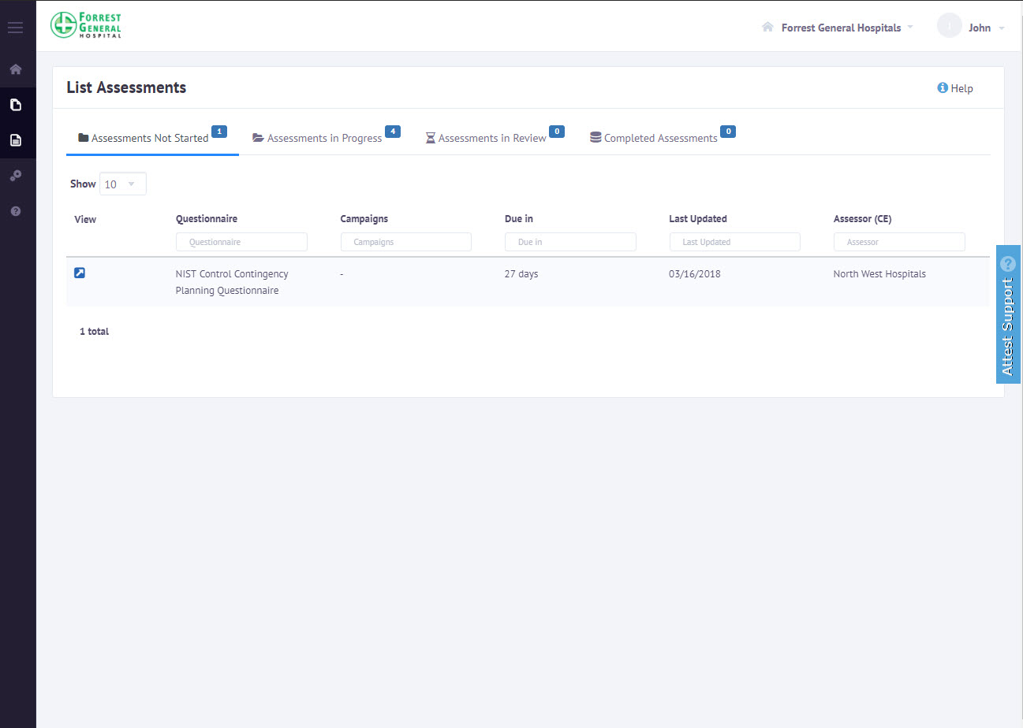
Respondent doing Assessments
14
List all assigned assessments in dashboard for selected account
1
Respondent Assessment
Respondent can start answering the questions.
2
Update Assessments
For each question either choose a value from the drop-down menu, or use the text area to enter descriptive text.
3
Save Assessment
To save the responses added, click on the Save button.

Slide 15
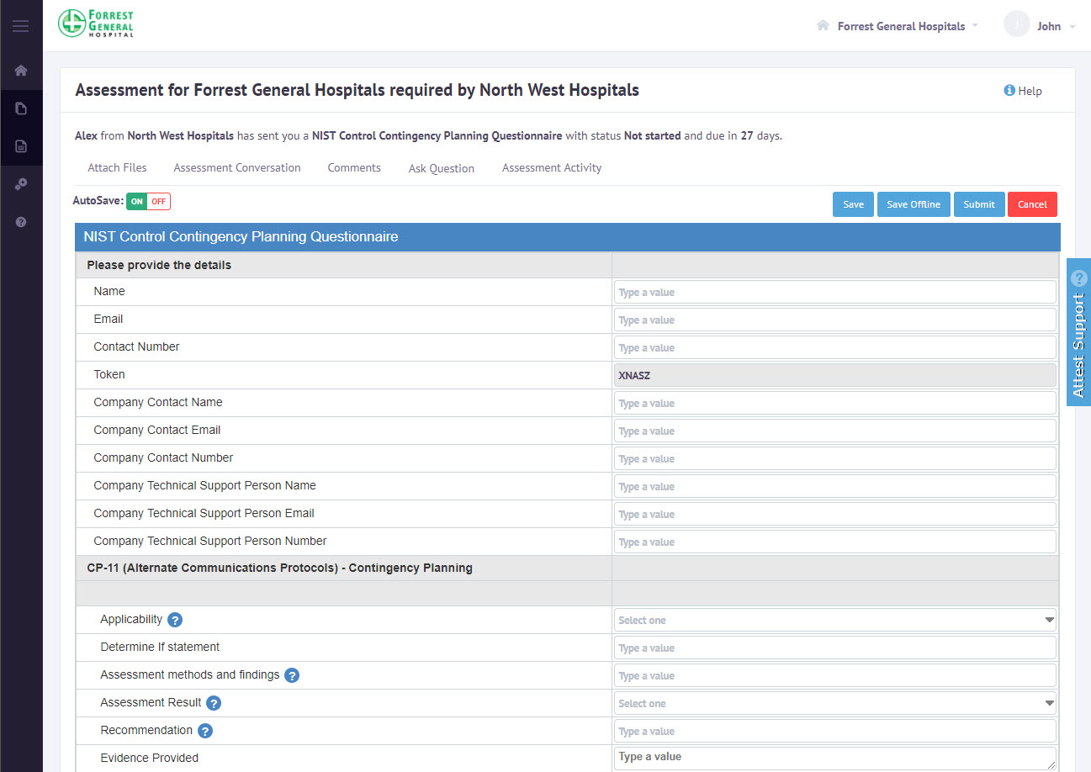
Respondent doing Assessments
15
Respondent can Save, Submit or Save offline
1
Save Assessment
Respondent can start answering the questions and Save assessment
2
Save Assessments automatically
Automatically save assessments if keep auto save option Yes
3
Submit Assessments for review
Once completed assessments can be submitted for review

Slide 16
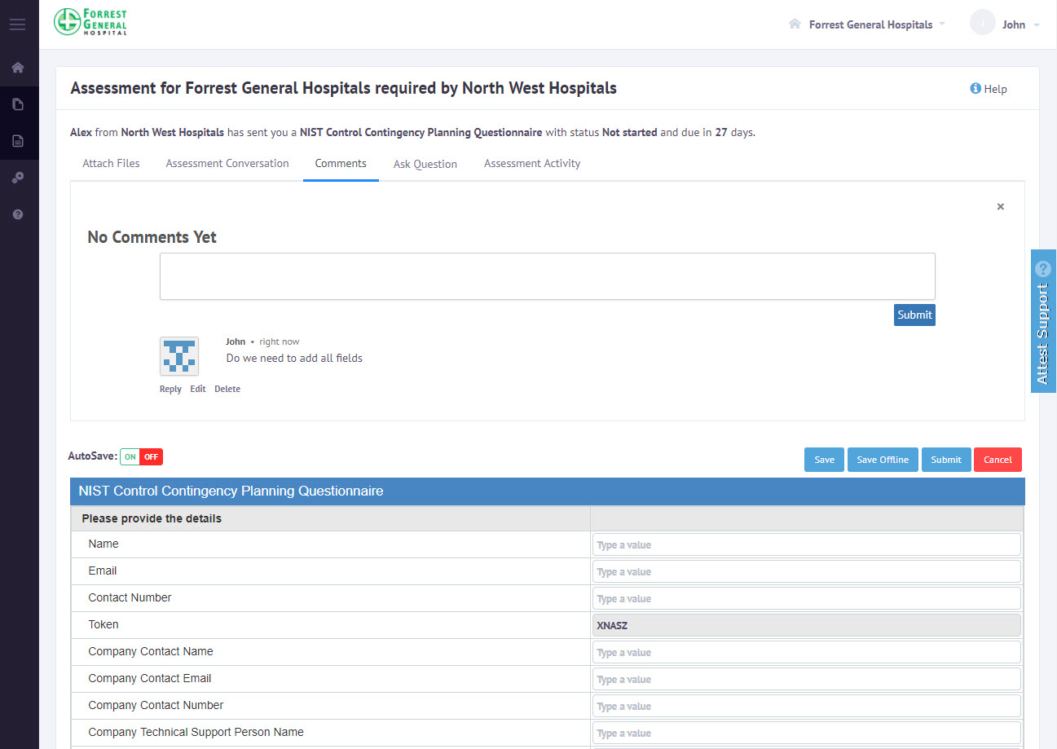
Commenting Capability
16
Assessment level comments for each questionnaire
1
Commenting System
Analysts or respondents can add comments and discuss about the questions within the system.
2
Threaded Comments
Commenting systems supports threaded comments.

Slide 17
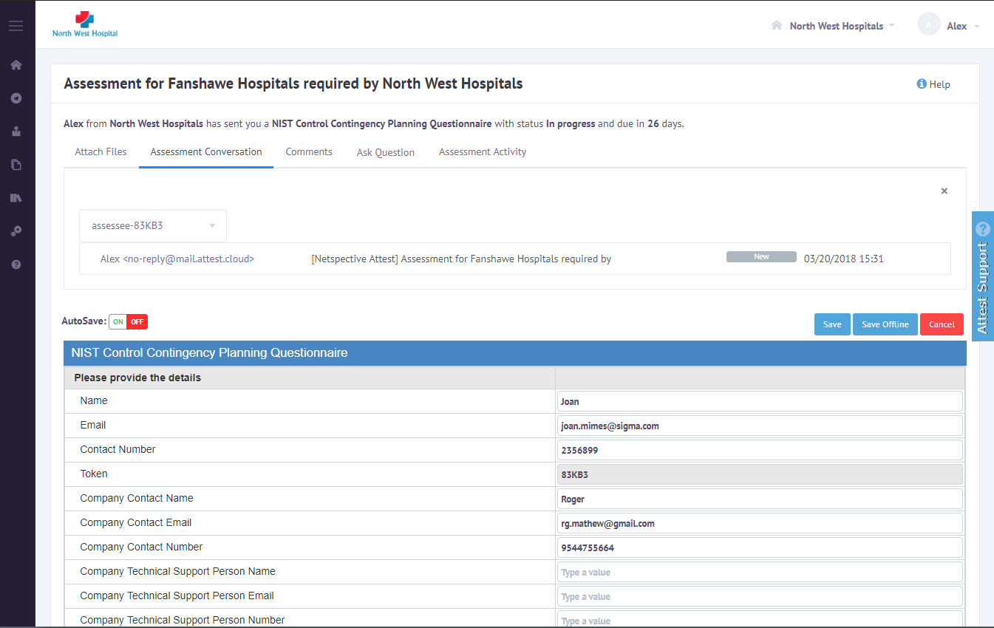
Conversations using emails
17
Email Communication between Analyst and Assessee
1
Communication
Respondents users can communicate with Analysts and ask clarifications on the questions.
2
Analyst Communications
Netspective Attest integrates with email communication subsystem and displays the email conversations.

Slide 18
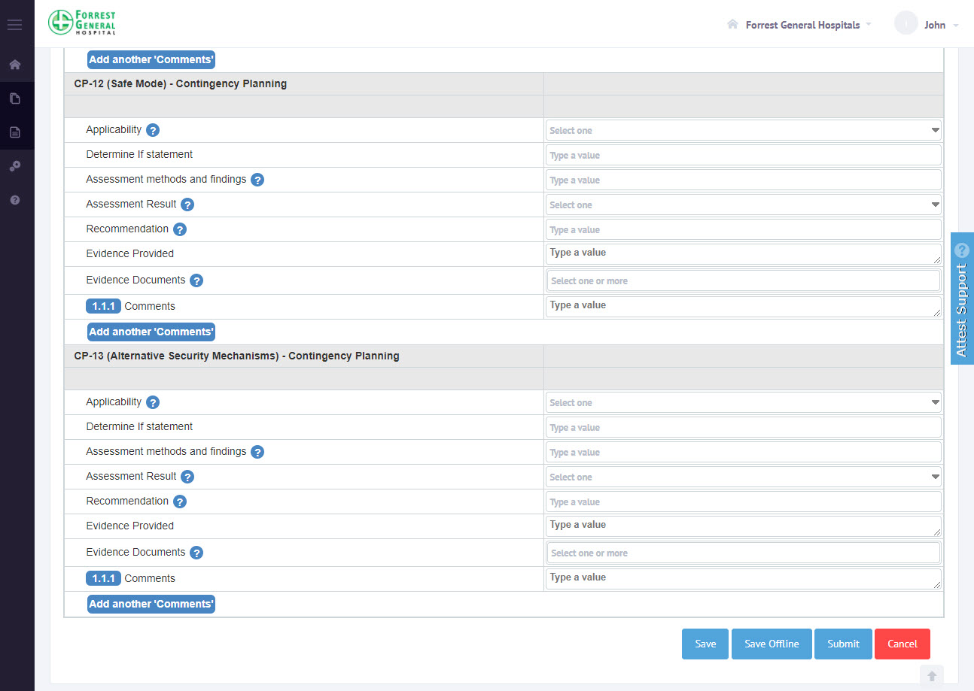
Save responses to questions
18
1
Save Response
Click on Save button, to save the responses added so far, and it will be available when the same questionnaire link is accessed next time.
2
Cancel
Click on Cancel button, to clear the unsaved filled data and refresh the page.
3
Submit
When the respondent has provided all the responses, he/she can submit the response for assessment

Slide 19
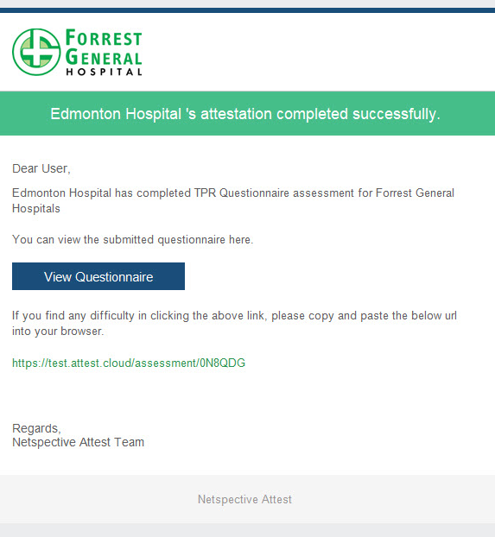
Email Notification on Submit Assessment
19
1
Email Notification for Analysts
Upon submitting the assessment, the respondent will get an email notification acknowledging the completion of the assessment
2
Email
A link to view the completed assessment is also included in the email

Slide 20
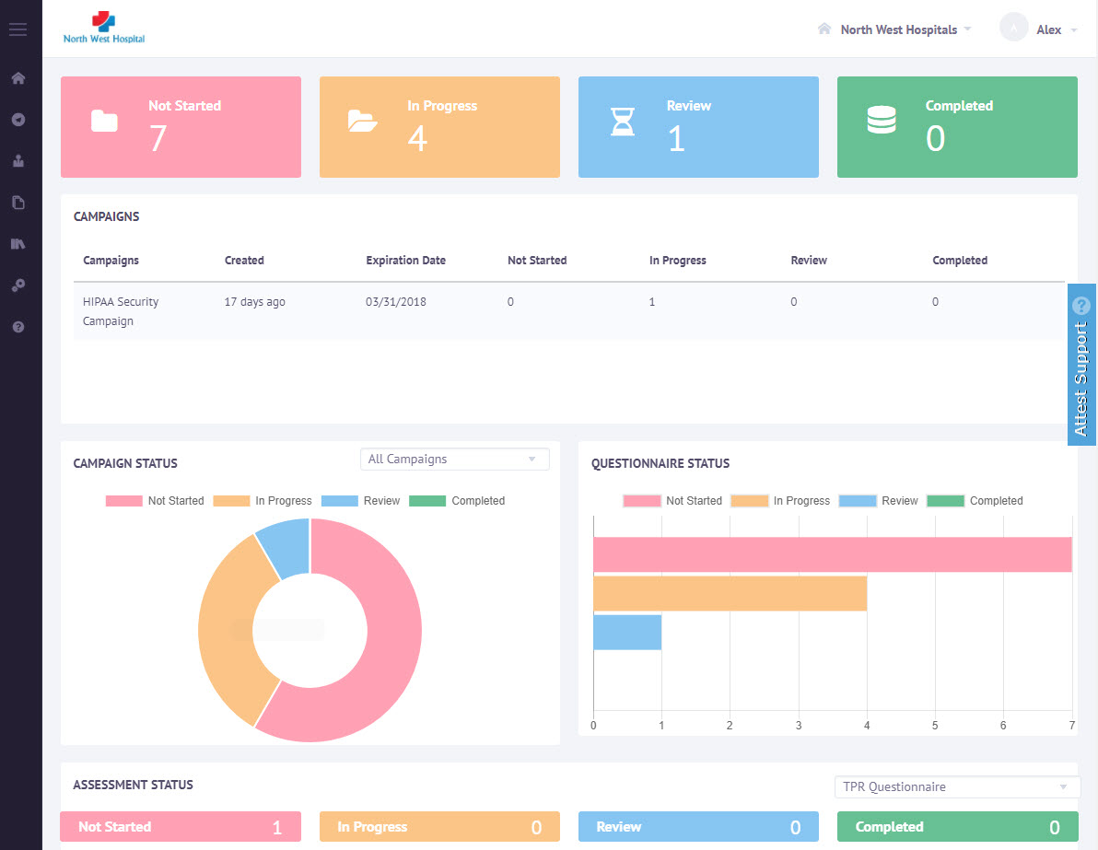
Analyst User Dashboard
20
List all assigned assessments in dashboard for selected Account
1
Login As Analyst
When an analyst logs in to Opsfolio Attest, the dashboard lists all the assessments, both ongoing and completed, from various Assessors.
2
Listing of Campaigns
The Campaign listing shows the assessments added in each campaigns.
3
Listing of Assessments
The assessment listing shows the assessor name and the status.

Slide 21
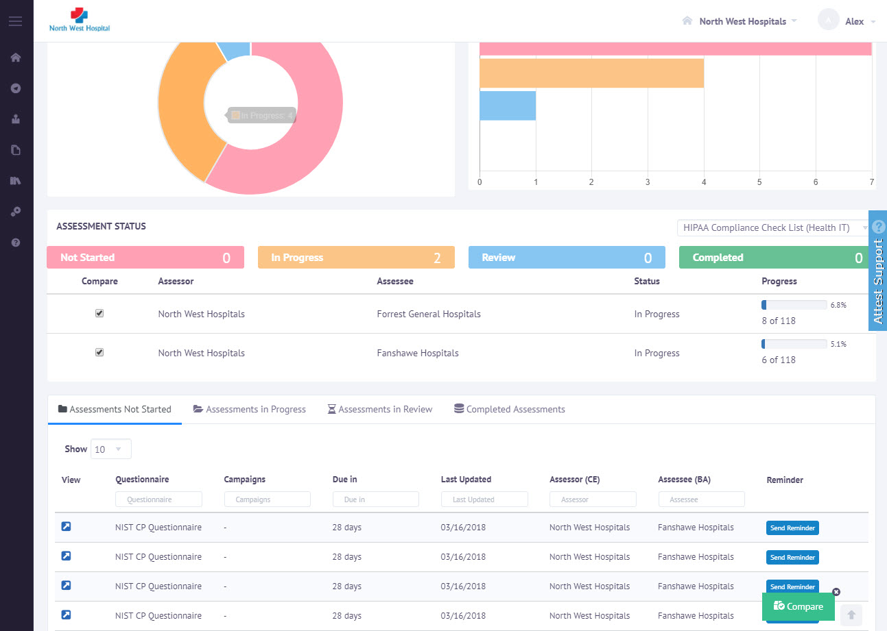
Compare Assessments
21
Select assessments of same questionnaire
1
Select Assessments
Analyst can select assessments from the dashboard lists all the assessments, both ongoing and completed, from various Assessors.
2
Compare Assessments
On checking checkboxes click on Compare Button to get comparison

Slide 22
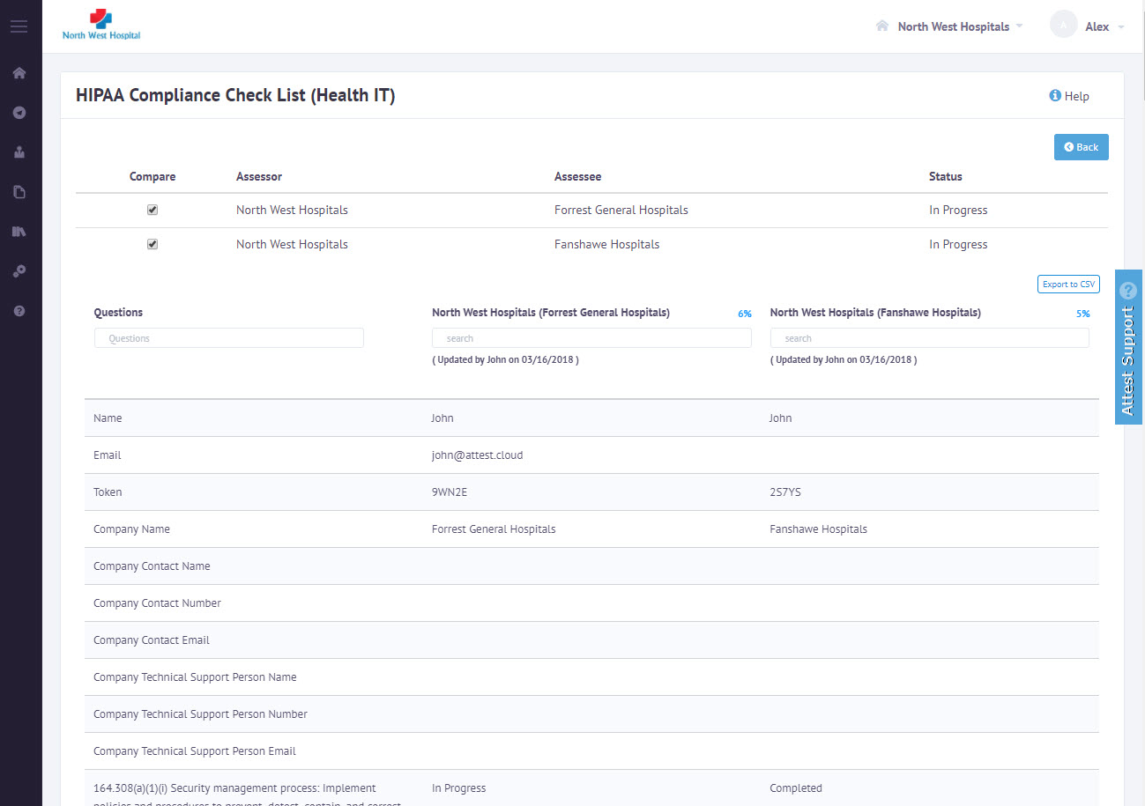
Compare Assessments and Export
22
Select assessments of same questionnaire
1
View each assessments in columns
Analyst can view assessment questionnaires in first column and selected assessments data in next columns
2
Export comparison data
Export data as CSV file with assessment data in each columns

Slide 23
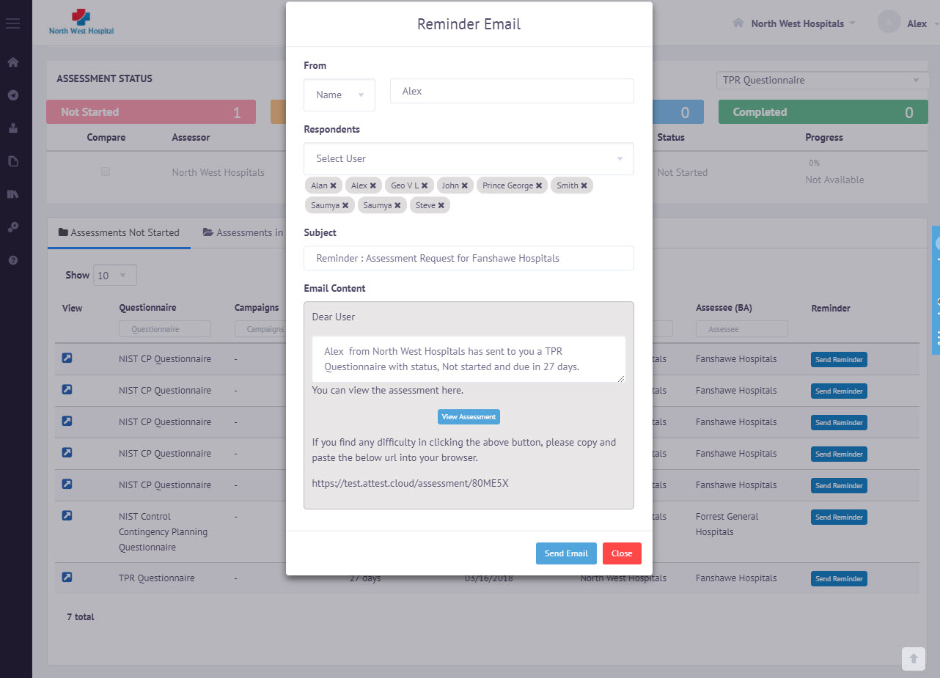
Reminder for Assessment
23
1
Instructions
An email template is provided with default content. To send a customized email, the analyst can edit the content
2
Name
Sender name can be either the analyst name or can be system generated
3
Send Reminder Email
Send Email Button will send reminder email with the assessment link to the respondents

Slide 24
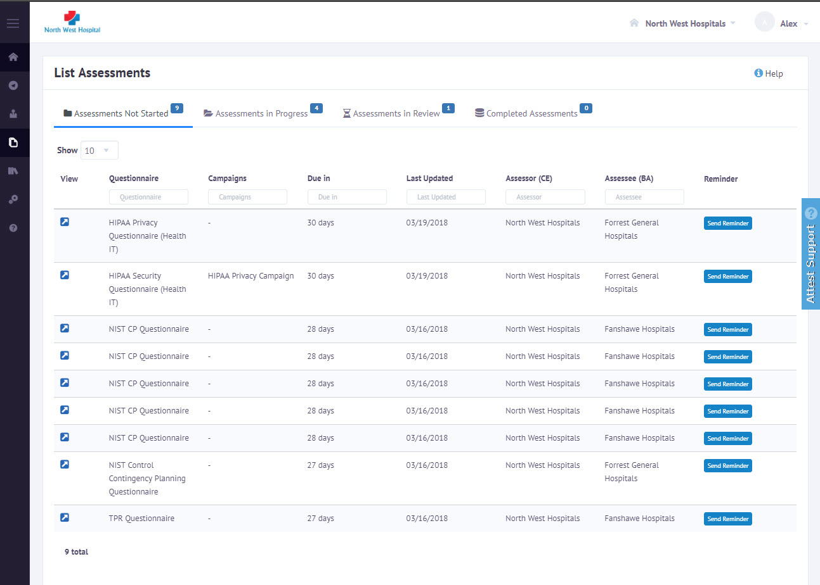
View responses submitted
24
1
List Assessments based on Status
Assessments are categorized according to the status and shown in different tabs
2
Open Assessment
From the list any assessment can be opened

Slide 25
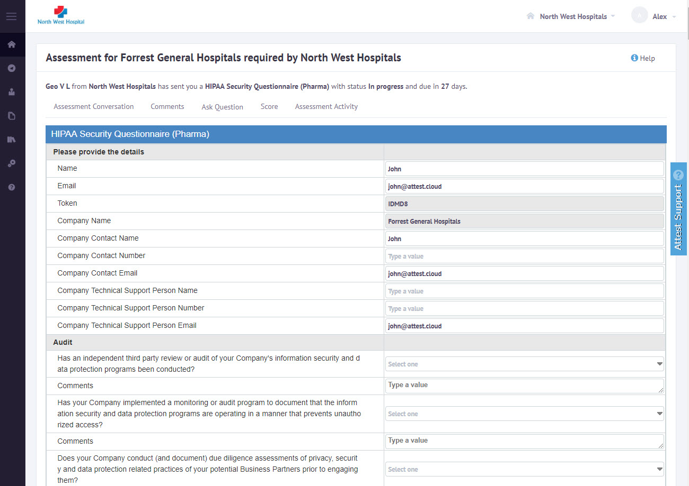
View responses submitted
25
1
Review
Here the Analyst can review the questionnaire responses submitted by Respondent
2
Review Complete
Assessment process can be completed by clicking Review button
3
Score
View Assessment scores based on custom rules set by creation of questionnaires

Slide 26
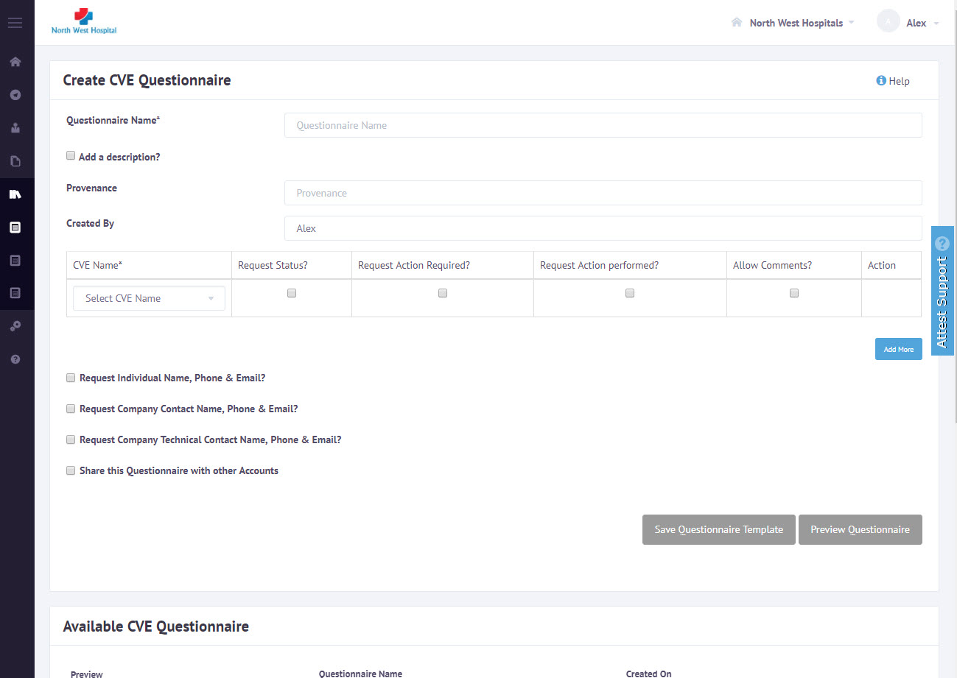
Create CVE Questionnaire
26
1
Create CVE Questionnaires
Create a CVE Questionnaire by adding one or more CVEs and select the necessary predefined options to be added with each questionnaire
2
Preview
Show the CVE Vulnerability Questionnaire generated based on selected CVEs
3
Share Assessments
By saving Questionnaire will available on Create Assessments Page

Slide 27
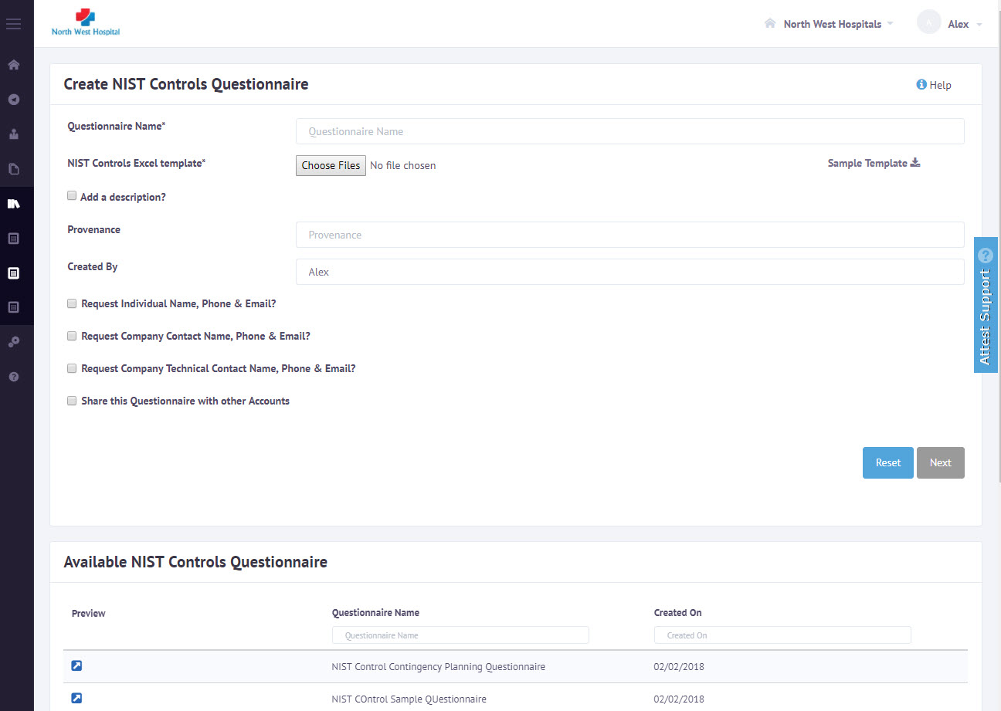
Create NIST Controls Questionnaire
27
1
Create NIST Controls
A customized list of NIST 800-53 controls can be imported into Opsfolio Attest
2
Preview
Shows the preview questionnaire generated based on the imported controls.
3
Share Assessment
By saving Questionnaire will available on Create Assessments Page

Slide 28
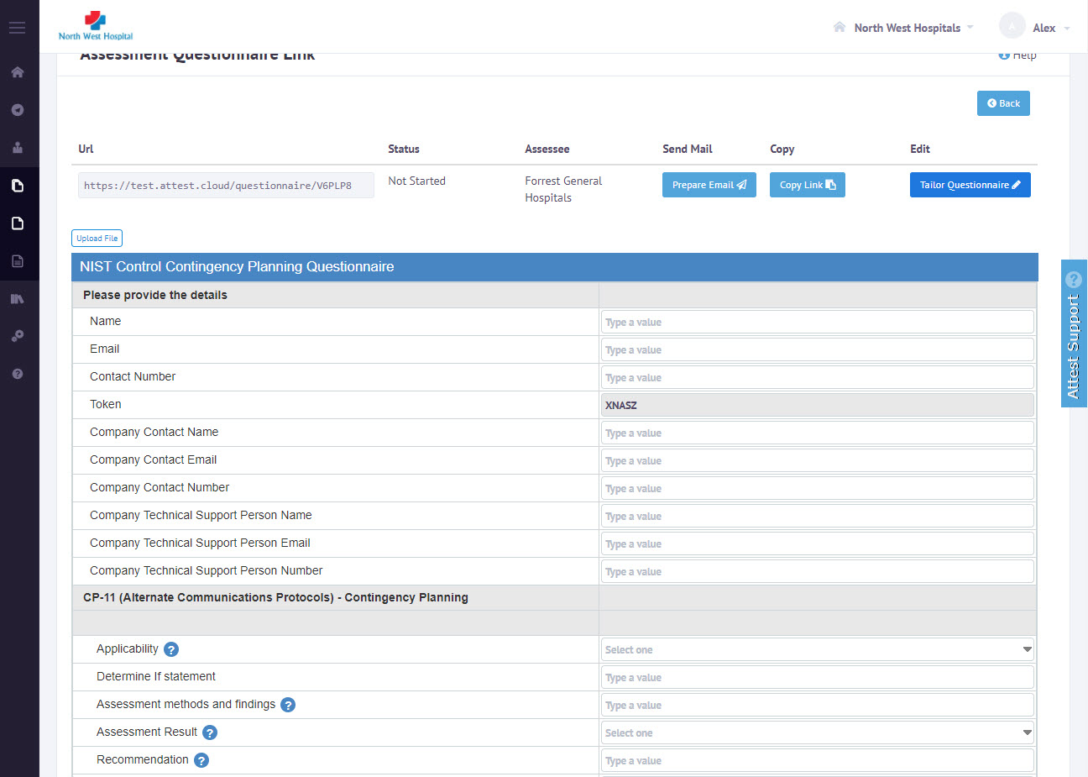
Tailor Questionnaire before sending
28
1
Create Assessments
Create Assessments from the list of questionnaires available
2
Save & Tailor Assessments
After saving assessments analyst able to add answers and attach files to the assessment
3
Share Assessment
By saving Questionnaire will available on to the assessee

Slide 29
Thank you

